Slide 1
INTRODUCTION TO
PATHOLOGY
Dr.Kaduyu Dennis
SUBTOPIC 1CONCEPTS TO PATHOLOGY
SUBTOPIC 2 CAUSES,CLASSIFICATION AND PATHOGENICITY OF DISEASES
SUBTOPIC 3 PHYSIOLOGIC STRESS AND PATHOLOGICAL INJURY AND CELLULAR ADAPTATION
SUBTOPIC 4CELL INJURY AND CELL DEATH

Slide 2
CONCEPTS TOP PATHOLOGY
LEARNING OBJECTIVES
Define the term pathology
Define terms used in pathology
Branches of pathology
Classifications used in the study of pathology
Techniques of pathology
Importance of studying pathology

Slide 3
Definition of Pathology
Pathology is the study of disease by scientific methods.
The word pathology comes from Latin words “pathos” meaning suffering or disease and “logy "meaning study ,hence study of disease.
It focuses on structural, functional and biochemical changes in cells ,tissues and organs in disease.
Ultimate goal: identification of the cause of dse, leading to successful therapy & disease prevention.

Slide 4
TERMS USED IN PATHOLOGY
Its important to be familiar with the language used in pathology.
Define patient,lesions,pathogenesis,symptoms and signs.
Patient; is the person affected by disease.
Lesions; are the characteristic changes in tissues and cells produced by disease in an individual eg wound,tumor, sores etc

Slide 5
Etiology of disease; means cause of the disease
if the cause of the disease is known it is called –Primary etiology
if the cause of the disease is unknown it is called -idiopathic
There are 2 major classes of etiologic factors i.e genetic or acquired

Slide 6
Pathogenesis of disease; mechanism by which lesions are produced.
Symptoms; functional implications of the lesions felt by the patient
Signs ; functional implications of the lesions discovered by the clinicians
?fever sign or symptom

Slide 7
SUMMARY
Clinical significance of the morphologic and functional changes together with results of other investigations help to arrive at an answer to what is wrong (diagnosis), what is going to happen (prognosis), what can be done about it (treatment), and finally what should be done to avoid complications and spread (prevention).

Slide 8
Pathognomonic abnormalities
These are characteristics of a disease distinguishing it from other diseases
E.g. Reed-Sternberg cells(large lymphocytes, B cell in origin, in HD( Hodgkin's disease), polyuria,polydysia and polyhagia in diabetes.
Some disease are x- terized by combination of abnormalities & these are called syndromes. Examples

Slide 9
Carpal tunnel syndrome
results from compression of median nerve in the carpal tunnel combination of abnormalities include (pain,tingling or pricking sensation over distribution of median nerve

Slide 10
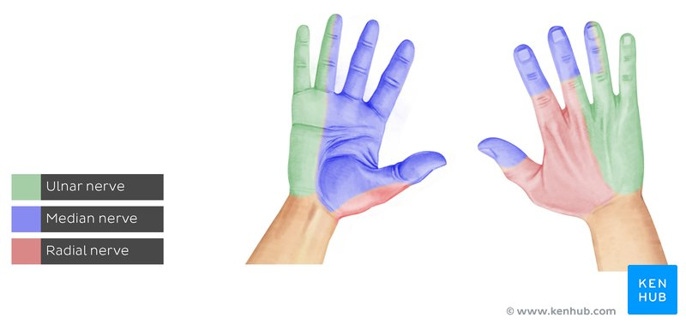

Slide 11
Meig’s syndrome
Cause not known. combination of triad abnormalities include(ascites, pleural effusion and benign ovarian tumor

Slide 12
BRANCHES OF PATHOLOGY
General pathology;
Deals with general principles of disease. i.e common changes in all tissues eg inflammation,cancer,aging.
general pathology is the foundation of knowledge that has to be laid down
Systemic(organ and organ system) pathology is the study of diseases pertaining to the specific organs and body systems.eg goiter, pneumonia, breast cancer

Slide 13
CLASSIFIACATIONS/SUBDISIONS OF PATHOLOGY
Histopathology: investigation and diagnosis of disease from examination of tissues.
3 main sub divisions of histopathology
surgical pathology; study of tissue removed from living body.
forensic pathology; study of organs and tissues removed at postmortem for medicolegal work and understanding
c) Hematology: study of disorders of blood components.

Slide 14
the underlying sequence and cause of death.
cytopathology; study of cells shed off from the lesions (exfoliative cytology) and fine –needle aspiration cytology(FNAC)of superficial and deep seated lessions for diagnosis.
b)Heamatogy;study of disorders of the cellular and coagulable components of blood

Slide 15
C) Chemical pathology; study of biochemical constituents of blood, urine ,semen, CSF and other body fluids which include proteins,lipids,carbohydrates,fats,vitamins and glucose.
D)Immunology ; study of specific defense mechanisms of the body.eg autoimmune diseases,hypersensivity rections,transplant rejection
E)Molecular pathology; detection and diagnosis of abnormalities at the level of DNA of the cell

Slide 16
Microbiology: the study of diseases by isolating, identifying and treating infections such as bacteria, fungi, viruses and parasites. Microbiology is often further divided into virology, bacteriology, mycology and parasitology.
Genetics: study of abnormal chromosomes and genes and their patterns of inheritance in causation of disease.
Toxicology: study of effects of known or suspected poisons in the body

Slide 17
Techniques of Pathology
Ways of studying pathology
Gross pat (morbid anatomy): observation made by naked eye
Light microscopy: use of light microscope to study structural changes in cells and tissues in disease.
Histochemistry: study of chemistry of tissues after they have been treated with specific reagents so that features specific to individual cells can be visualized.

Slide 18
Techniques of pathology
Immunohistochemistry & immunofluorescene: These employ antibodies to visualize subs in tissue sections or cell preservations. It uses antibodies linked chemically to enzymes or fluorescent dyes respectively.
Electron microscopy: study of disorders at organelle level to demonstrate viruses in tissues.
Biochemical techniques: use of clinical chemistry to monitor fluid, electrolyte, body enzymes in disease conditions.

Slide 19
Techniques in pathology
Hematological techniques: used to dx blood disorders. E.g. simple cells counting &assays of bld coagulation factors.
Medical microbiology: study of dses caused by microbes, tech used include microscopy, culture & sensitivity.

Slide 20
Practical exercise
1 Identify pathology specimen
2 Filling in request forms for investigations
3 Pack and transport pathology specimen

Slide 21
Building knowledge and understanding
Pathology should be dealt with in an orderly and logical manner. For each dse condn, the major xtics which should be considered include:
Definition
Epidemiology
Aetiology
Pathogenesis
Pathological & clinical features
Prognosis
Treatment
Prevention

Slide 22
Making diagnosis
Diagnosis is the act of naming a disease in an individual patient.
It enables the patient to benefit from available known Rx.
It involves:
Taking clinical h/o to document symptoms.
Exam to elicit signs and clinical stage
Performing of investigations based on the s&s.

Slide 23
QUESTION
Importance of studying pathology??

